Slide 1

SHORT RANGE ULTRASONIC RADAR
SRI SIDDHARTHA INSTITUTE OF TECHNOLOGY
DEPARTMENT OF COMPUTER SCIENCE AND ENGINEERING
A HOBBY Project
By:
NEHA ACHARYA : 20CS051
PRATHUSAHA K B : 20CS058
Guide:
Dr. Renukalatha. S, M.S,PhD,MISTE
Professor,
Dept. of CSE
SSIT,Tumkur

Slide 2
Introduction
Radar is an object detection system that uses electromagnetic waves to identify range, altitude, direction, or speed of both moving and fixed objects.
When we use ultrasonic waves instead of electromagnetic waves, we call it ultrasonic radar.
The main components in any ultrasonic radar are the ultrasonic Sensors.
Ultrasonic sensors work on a principle similar to radar or sonar which evaluates attributes of a target by interpreting the echoes from radio or sound waves respectively.
Radar’s information will appear in different ways. Like sound or LED

Slide 3
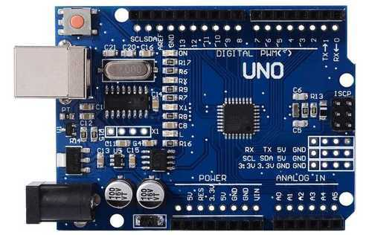
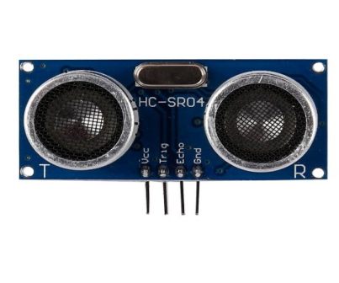
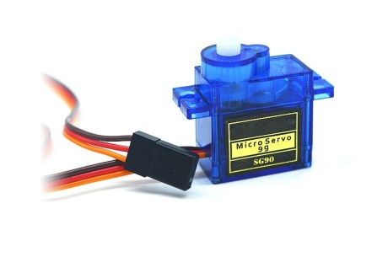
Tools and technologies
Arduino Board UNO Model
Arduino is a hardware and software company,basically microcontroller-based kits for building digital devices and interactive objects that can sense and control physical devices.
Ultrasonic sensors HC- SR04
An ultrasonic sensor is a sensor that is used to measure the distance of a target or object. It detects the object by transmitting ultrasonic waves and converts the reflected waves into an electrical signal.
Servo Motor tower pro micro servo 9g
The servo meter is a simple DC motor that can be controlled for specific angular rotation with the help of additional servomechanism.

Slide 4
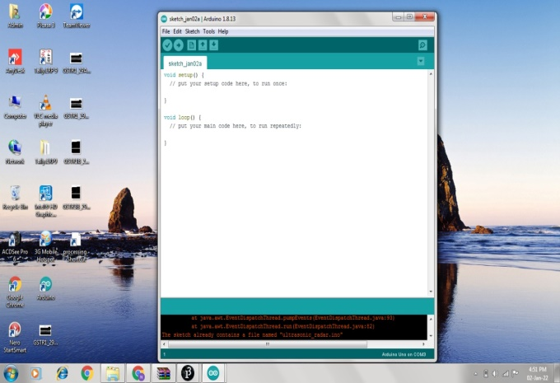
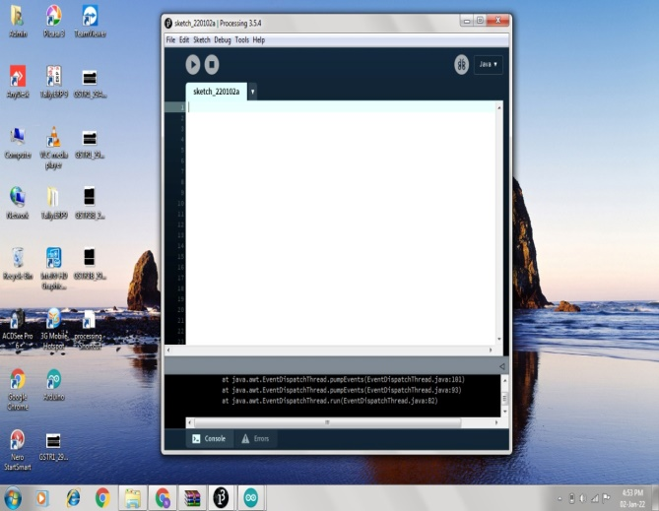
Tools and technologies
Arduino IDE 1.8.13
For programming the microcontrollers, the Arduino project provides an integrated development environment (IDE) makes it easy to write code and upload it to the board.
Processing IDE
Processing application is visual arts-based software for learning to code.

Slide 5
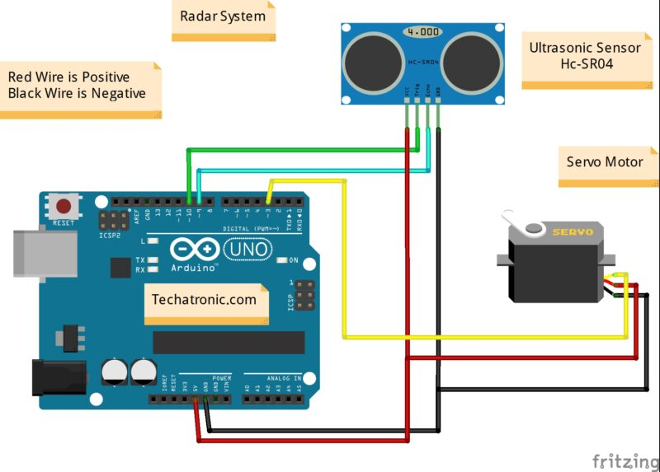
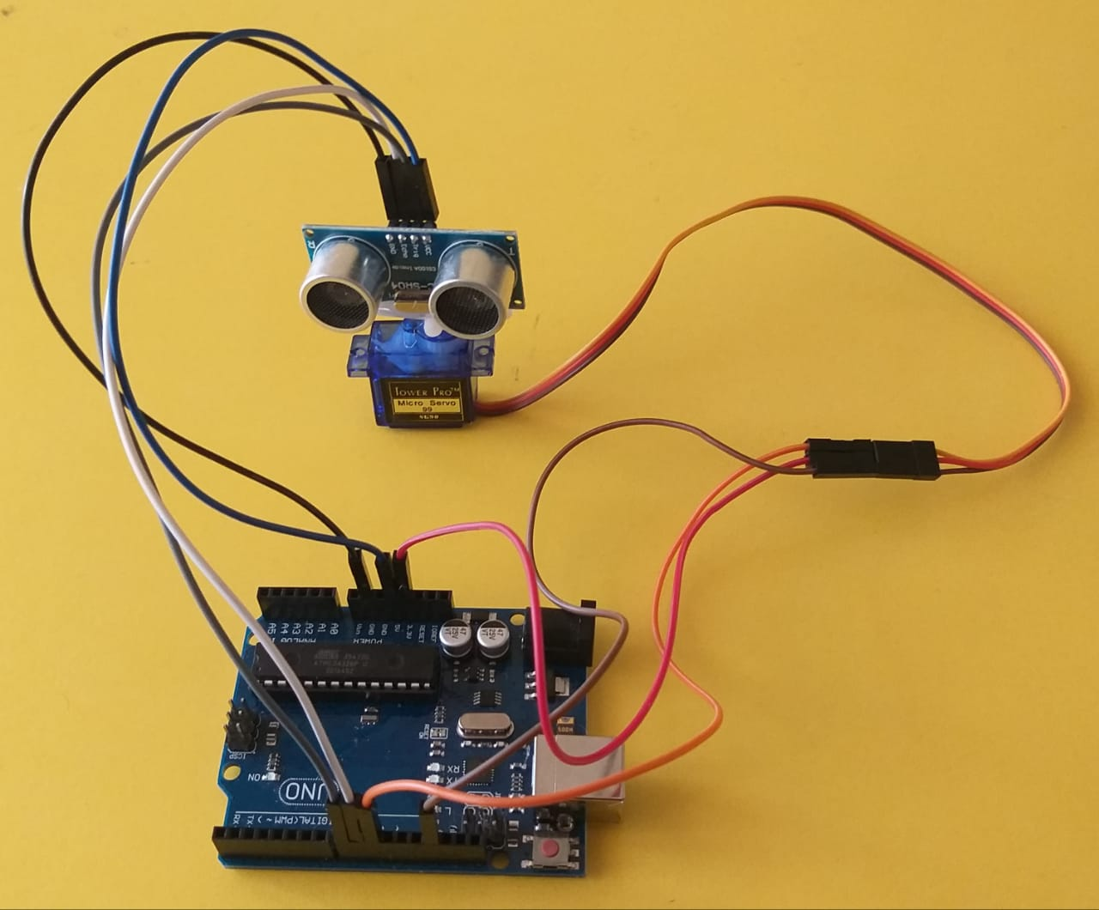
Working procedure : Hardware
Circuit Diagram
We connected the Ultrasonic Sensor HC-SR04 to the pins number 10 and 11 on the Arduino Board.
Trig Pin = 8.
Echo Pin = 9.
And the servo motor to the pin number 10 on the Arduino Board. Fig (9) shows circuit structure for the project.
My Servo = 10.
Final appearance of circuit

Slide 6
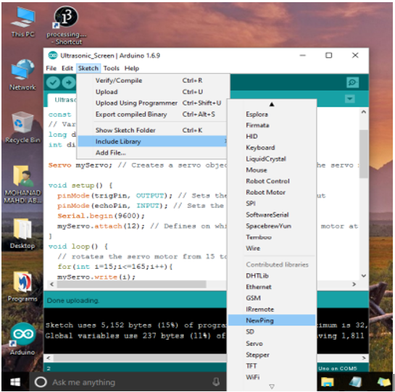
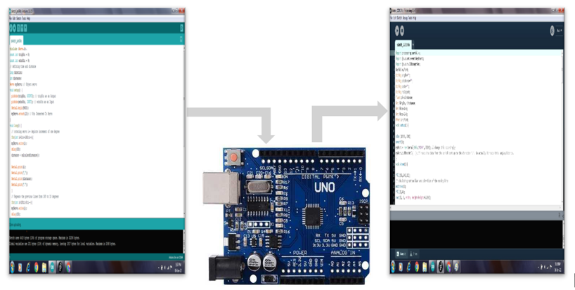
Working procedure : Software
Write and upload sketch to Arduino
We wrote a sketch in IDE, for this project we need to include some libraries. We use (Serial.h) built-in library for transfer data through the serial port with processing software.And we add the last library for servo motor (Servo.h)
Then, we make a code and upload it to the Arduino board to enable the interaction between the Arduino and the Processing IDE.

Slide 7
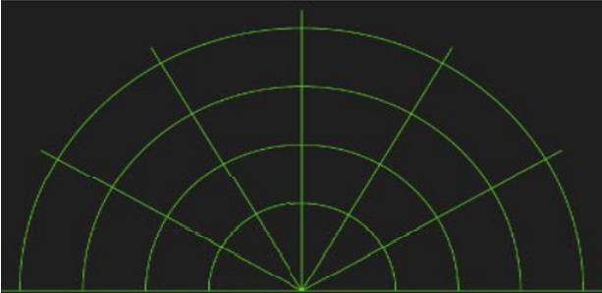
Working procedure : Software
Write and upload sketch to Processing
The values for the angle and the distance measured by the sensor will be read from the Arduino board by the Processing IDE using the SerialEvent() function which reads the data from the Serial Port.
For drawing the radar display we make this function drawRadar() which consist of arc() and line() functions.
For drawing the moving lines we make this function drawLine().
For center of rotation we use translate() function and using the line() function in which the i Angle variable is used to redraw the line for each degree.
For drawing the detected objects we made the drawObject() function.
To illustrate the text on the screen, we make the drawText() function.
The Radar Workspace

Slide 8
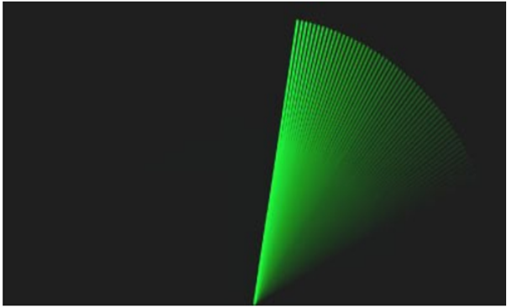
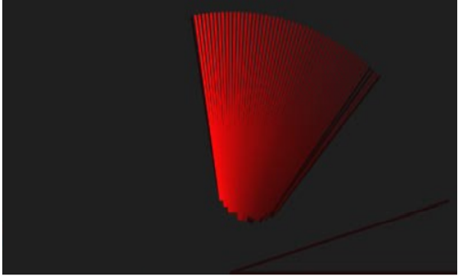
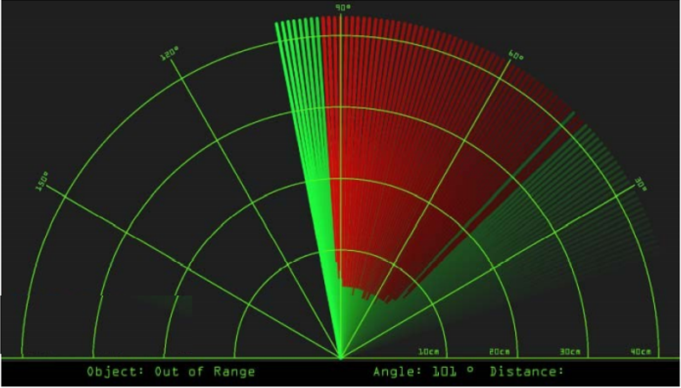
Output
After uploading the code, the servo motors start running from 0 to 180 degrees and again back to 0 degrees. An ultrasonic sensor also rotates along with the servo as it is mounted on the motor.
Now, open the processing application and paste the above code. In this code, update the COM port number where your Arduino board is connected.
Now, run this processing code. If your code is right then, you will get a new window. This is the graphical representation of data from the Ultrasonic Sensor is represented in a radar type display.
If an ultrasonic sensor detects any object within its range, you can see the same on the graphical representation. The below gif shows the output of the Arduino radar project.
Radar Lines
Radar detected lines
Radar Screen

Slide 9
Applications
Applications
This Radar System have various applications for security purposes and it is mainly used for mapping.
APPLCATION IN AIR FORCE: It is used in airplanes or aircraft machines.
APPLICATION IN MARINE: This radar system also used in ships or marine.
APPLICATON IN METEROLOGY: Meteorologists also uses radar systems to track or monitor the wind.

Slide 10
Conclusions
This project could be helpful for object avoidance/ detection applications. This project could easily be extended and could be used in any systems may need it. This framework can also be developed or modified according to the rising needs and demand.

Slide 11
References
Ultrasonic Radar and its applications: https://scholar.google.co.in/scholar?q=ultrasonic+radar+applications&hl=en&as_sdt=0&as_vis=1&oi=scholart
Arduino UNO: https://en.wikipedia.org/wiki/Arduino
Servo motor datasheet.
Ultrasonic Sensors: https://www.solidswiki.com/index.php?title=Ultrasonic_Sensors
Circuit Diagram: https://techatronic.com/radar-using-arduino-ultrasonic-sensor/
Arduino IDE and Processing Code: http://howtomechatronics.com/projects/arduino-radar-project/

Slide 12
Thank you

